Slide 1
Postgraduate Literacies & Research Skills Workshops
Workshop 5: Ethical Considerations
Presented by :
Tapiwa Gundu (PhD)

Slide 2

Research Ethics
Ethics are the moral principles that a person must follow, irrespective of the place or time. Behaving ethically involves doing the right thing at the right time. Research ethics focus on the moral principles that researchers must follow in their respective fields of research.

Slide 3
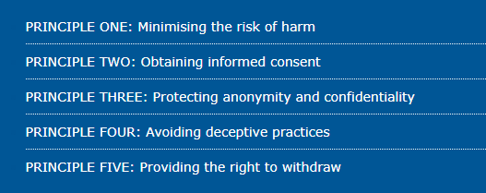
Ethical Principles of Research

Slide 4
PRINCIPLE ONE: Minimising the risk of harm
There are a number of types of harm that participants can be subjected to. These include:
Physical harm to participants.
Psychological distress and discomfort.
Social disadvantage.
Harm to participants? financial status.
An invasion of participants? privacy and anonymity.
In order to minimising the risk of harm you should think about:
Obtaining informed consent from participants.
Protecting the anonymity and confidentiality of participants.
Avoiding deceptive practices when designing your research.
Providing participants with the right to withdraw from your research at any time.

Slide 5
PRINCIPLE TWO: Obtaining informed consent
Informed consent means that participants should understand that
they are taking part in research as volunteers and
what the research requires of them.
Such information may include:
the purpose of the research,
the methods being used,
the possible outcomes of the research,
as well as associated demands, discomforts, inconveniences and risks that the participants may face.
Whilst is it not possible to know exactly what information a potential participant would (or would not) want to know, you should aim not to leave out any material information; that is, information that you feel would influence their decision on giving consent.

Slide 6
PRINCIPLE THREE: Protecting anonymity and confidentiality
Protecting the anonymity and confidentiality of research participants is another practical component of research ethics.
After all, participants will typically only be willing to volunteer information, especially information of a private or sensitive nature, if the researcher agrees to hold such information in confidence.
An possible solution is to remove identifiers (e.g.,
vernacular terms,
names,
geographical cues, etc.) or
provide proxies when writing up.

Slide 7
PRINCIPLE FOUR: Avoiding deceptive practices
Deceptive practices fly in the face of informed consent.
After all, how can participants know
that they are taking part in research and
what the research requires of them if they are being deceived?
This is part of what makes the use of deceptive practices controversial.
For this reason, in most circumstances, dissertation research should avoid any kinds of deceptive practices.
“Deception occurs as the result of investigators providing false or incomplete information to participants for the purpose of misleading research subjects.”

Slide 8
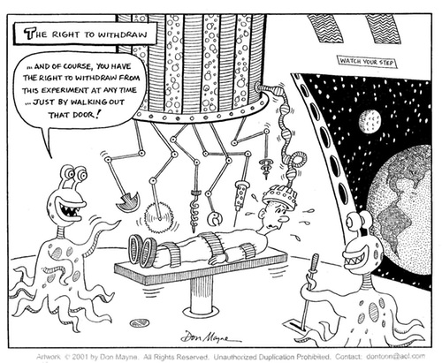
PRINCIPLE FIVE: Providing the right to withdraw
A participant can leave a research study at any time.
When withdrawing from the study, the participant should let the research team know that he/she wishes to withdraw.
A participant may provide the research team with the reason(s) for leaving the study, but is not required to provide their reason

Slide 9
The Ethos of Science
Communalism
Scientific knowledge is public knowledge; freely available to all. The results of research do not belong to individual scientists, but to the world at large
Universalism
There is no privileged sources of scientific knowledge; the laws of science are the same everywhere and are independent of the scientists involved.
Disinterestedness
Scientists are unbiased; science is conducted in order to further human knowledge. They have no personal stake in the acceptance or rejection of data or claims.
Originality
Science is the discovery of the unknown; all scientific work must be novel, continually adding to the body of scientific knowledge.
Scepticism
Scientists take nothing on trust; knowledge, whether new or old, must always be scrutinized for possible errors of fact or inconsistencies of argument.

Slide 10
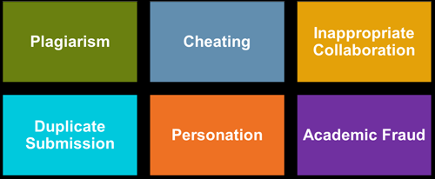
academic integrity
There are many types of academic dishonesty - some are obvious, while some are less obvious.
Cheating;
Bribery;
Misrepresentation;
Conspiracy;
Fabrication;
Collusion;
Duplicate Submission;
Academic Misconduct;
Disruptive Behavior;
and last, but certainly not least, PLAGIARISM.

Slide 11
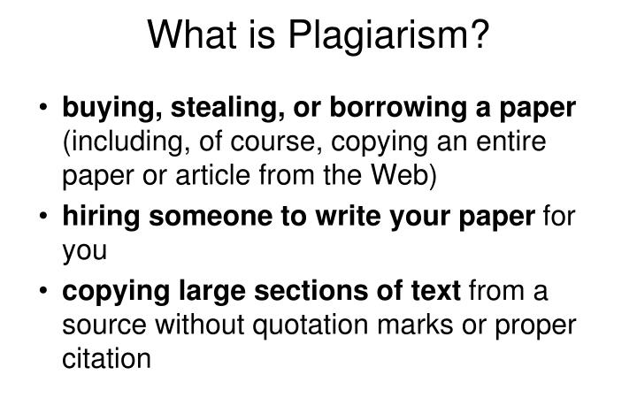

Plagiarism

Slide 12
Combating plagiarism
Paraphrase - Read and put into your own words. Make sure that you do not copy verbatim more than two words in a row from the text you have found. If you do use more than two words together, you will have to use quotation marks.
Cite - Citing is one of the effective ways to avoid plagiarism. Follow the document formatting guidelines (i.e. APA, MLA, Chicago, etc.) used by your educational institution. This usually entails the addition of the author(s) and the date of the publication. Not citing properly can constitute plagiarism.
Quoting - When quoting a source, use the quote exactly the way it appears. No one wants to be misquoted. Quoting must be done correctly to avoid plagiarism allegations.
Citing Quotes - Citing a quote can be different than citing paraphrased material. This practice usually involves the addition of a page number, or a paragraph number in the case of web content.
Citing Your Own Material - If you have already published some of the material you are using for your research you must cite yourself. Treat the text the same as you would if someone else wrote it. It may sound odd, but using material you have used before is called self-plagiarism, and it is not acceptable.
Referencing - One of the most important ways to avoid plagiarism is including a reference list at the end of your research paper. This information is very specific and includes the author(s), date of publication, title, and source.

